Slide 1

Odeta Qafoku
Biogeochemistry
Team Lead, EMSL
Sarah Leichty
Project Manager, EMSL
MONet user proposals
Current state of MONet
MONet 1st Year - Participant Sites
Plans for Soil Function Call in FY24
Notes:
Hi Everyone. I am Odeta Qafoku a Biogeochemistry Team Lead in EMSL and together with Sarah Leichty, who is Project Manager in EMSL we will present the plans for MONet User Proposals. This is exiting for us and for MONet current and future participants.
Briefly, we will discuss current state of MONet, MONet 1st year and participant sites, and finally Quarterly Soil Function call.

Slide 2

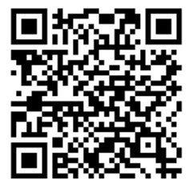
Soil Function Call 2023
Notes:
In 2023 we opened our 1st MONet User Proposal Call – which was called Soil Function Call.

Slide 3
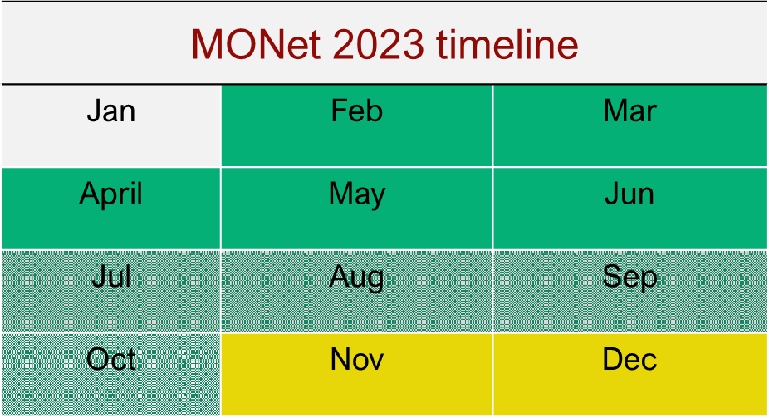
2023 Soil Function Proposal timeline
Jan | Feb | Mar
April | May | Jun
Jul | Aug | Sep
Oct | Nov | Dec
Annual open call
Soil cores process.
MONet - 2023
MONet 2024 Quarterly open call
February 14, 2023 – Opened 1st MONet User Proposal Call
An annual call: 200 sample sites as Internal Target
June 2023, Met EMSL Soil Processing capacity
Strong Response from User Community
Notes:
Going over the timeline,
Soil Function Call was launched as an annual call with an internal target of 200 sample sites.
The target was driven by our capacity to process soil samples, In June 23 we met our target,
We learned that User Community was very interested, collaborative and we were very encouraged by this strong response.
In FY 24 we are preparing to launch the Quarterly open call. But before I discuss this, I would like to talk about MONet current state.

Slide 4
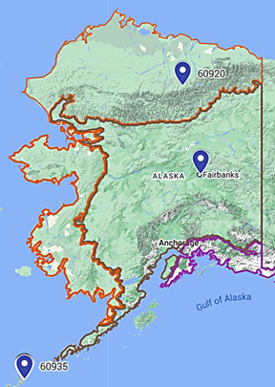
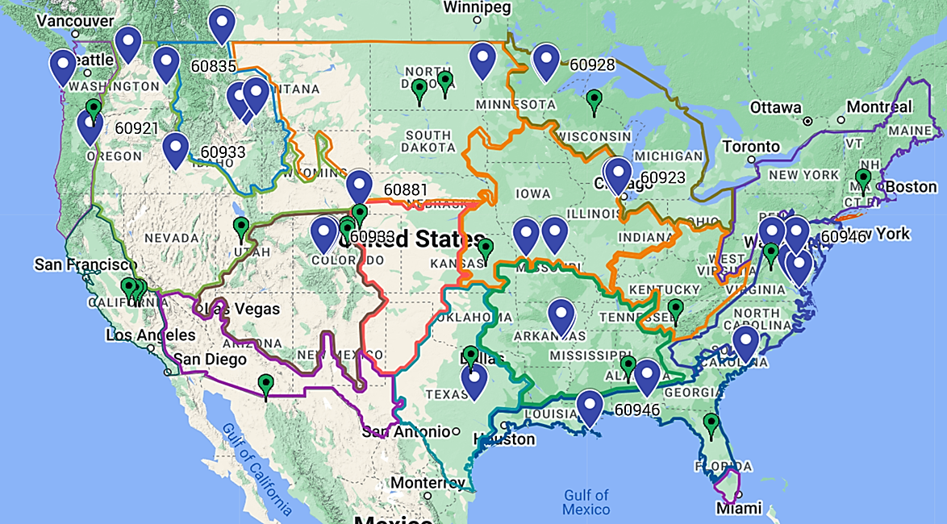
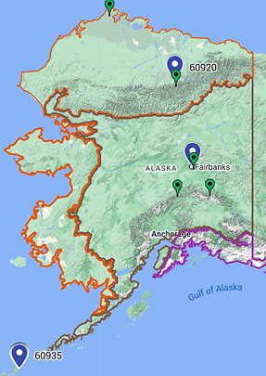
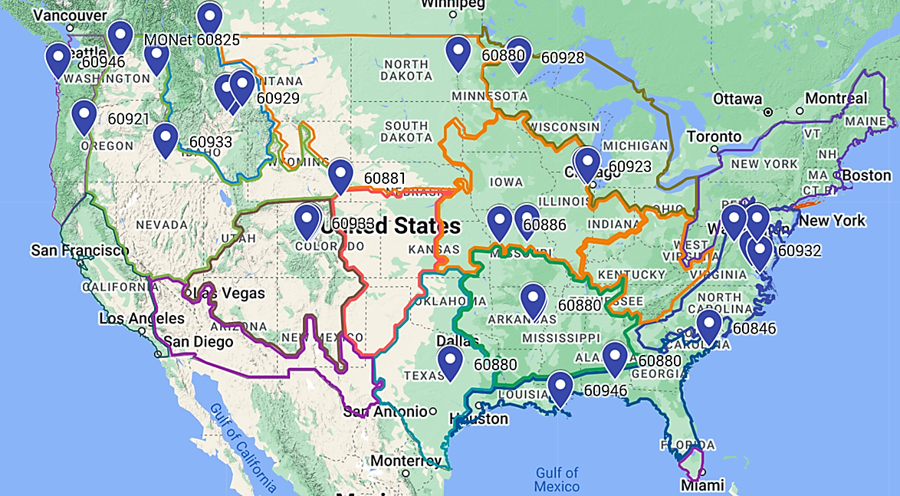
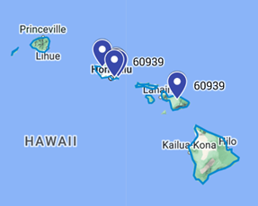
MONet Participant Sites in 2023
MONet | Single investigators (max. 6 sampling sets)
| Multi-disciplinary teams (max. 21 sampling sets)
NEON sites | Temporal measurements (28 high priority/sensitive sites)
Current State
Notes:
The proposal call was opened to Single investigators, (up to 6 sampling sets)
The proposal call was opened to Multi-disciplinary teams, (up to 21 sampling sets)
In June, we had received 29 MONet Soil Function Proposals (for tech review) ( with an estimate of180 sampling sets)
The proposals were distributed across US, no site clustering.
In addition, we included about 28 high priority/sensitive sites from our NEON ecological network partner.
Why, because this provides with Temporal measurements of these sites (as a reminder that we used NEON as a partner for MONet pilot – 1000 soils, where we collected first year of MONet data). For these particular NEON sites this will be a second year of MONet data.

Slide 5
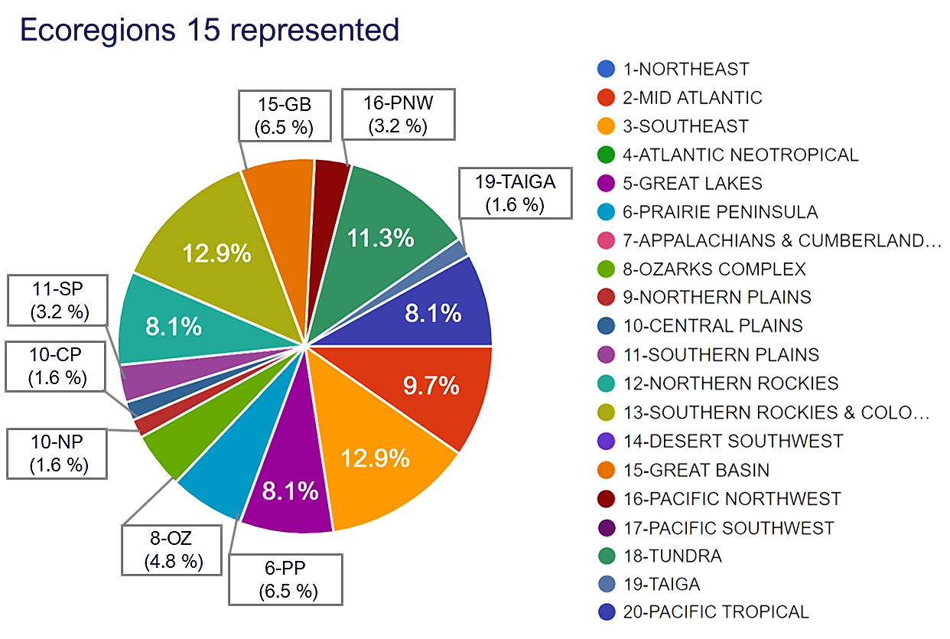
MONet 1st Year – 18 ecoregions represented
Current State
Notes:
The information here and in the next 2 slides is from metadata provided by MONet participants.
What do we learn, in the first year we received samples from 15 ecoregions, the ecoregion list is on the right. The greyed-out ecoregions are the ones that we did not receive sample sets.
The most represented sites are in blue and if you look closely at them, they are from high sensitive sites with regard to climate change.
If we include the NEON 28 sites in the list, then we represented 18 ecoregions in the first year of MONet.

Slide 6
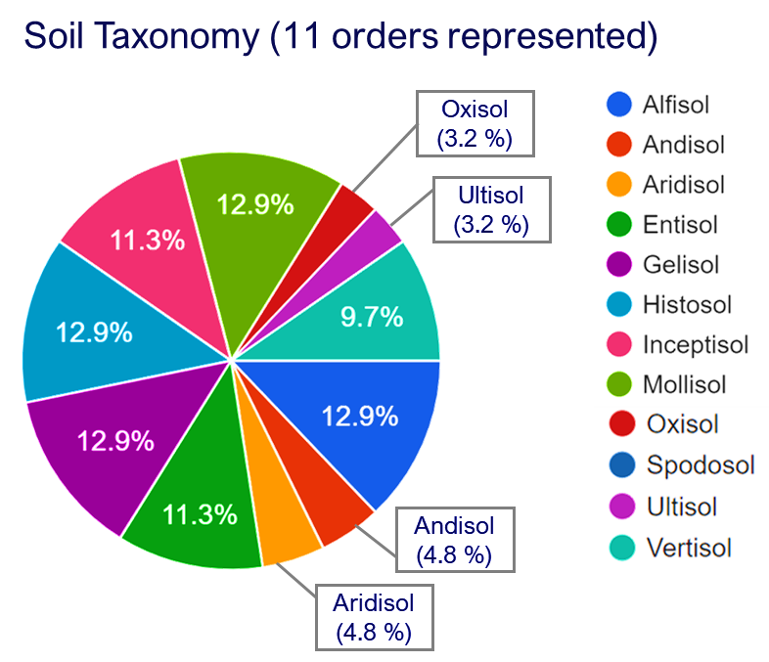
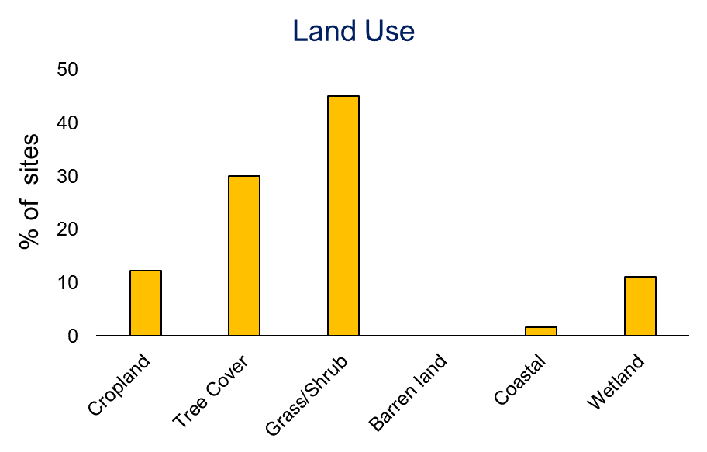
Current State
Notes:
What about soil taxonomy?
Based on the Metadata that were provided, Monet participant soil sites are from 11 soil orders in this first year of MONet sampling. The soils that are more represented, in blue, are from high fertility Mollisols, Alfisol, high organic C Histosol as well as Gelisol.
The Land Use Metadata is shown below. Land management is important with respect to C stability under different managements. Also is an important factor that can control soil physical properties.

Slide 7
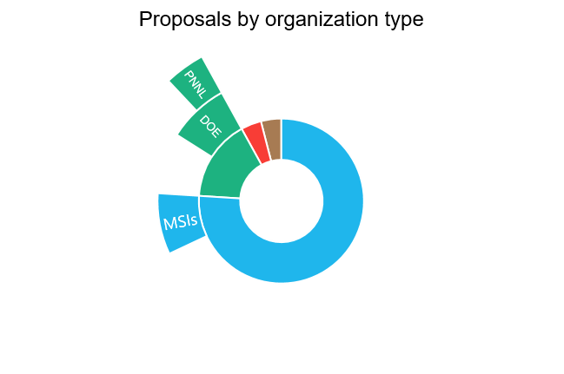
Current State
Private industry; other: 1 each
Gov. agency: 4
Academia: 17
Notes:
I will discuss here MONet participants characteristics, and in particular participation by organization type,
We see a strong contribution to the MONet annual call from academia. We would like more participation from the MSI and HBCU and ERI organization, and Sarah will discuss what we are doing to achieve this objective.
Lastly the distribution of MONet proposals by month, They are clustered around spring and early summer (which is when we closed our proposal call).
The information here is carefully vetted when we open the new MONet 2024 proposal call.

Slide 8

Key Takeaways
from MONet User Proposal, 2023
Maintain year-round MONet participation by managing high demand effectively,
Enhance efficiency in processing soil cores by optimizing EMSL team capacity.
Notes:
Other key take aways are managing high demand by maintaining a year-round MONet participation … this is public facing action, And, optimizing our EMSL team capacity, which internal facing action.
But the outcomes will be visible to MONet participants.

Slide 9
Quarterly Soil Function Proposal Calls
Spring soil function call
Summer soil function call
Fall soil function call
Winter soil function call
MONet CSM meeting
Launch searchable MONet data portal
Q1
Q3
FY 24
Q2
Q4
Notes:
Key timelines for MONet in FY 24. You should expect our Soil Function Quarterly Proposal calls to open very soon in November.
This call will be open 4 times a year, as shown here, in Spring, Fall and Winter. Sarah will describe some of these timelines more in detail.
Also we are here, at the MONet Community Science Meeting. You should also expect us to launch the searchable MONet data portal that Yuri discussed earlier today.

Slide 10
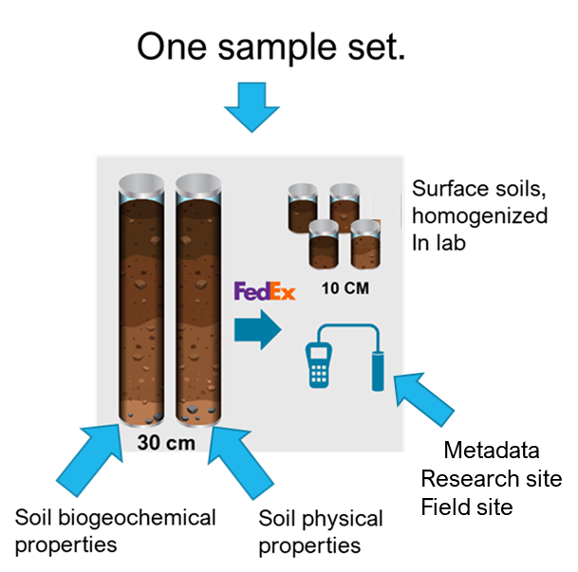
Small Scope Proposals
Individual PI or a small research team
Up to 9 sample sets
PI encouraged to provide open and complementary data resources
17 to 25 projects per year,
3 to 7 per quarter
Quarterly Soil Function
Notes:
Quarterly Soil Function Call, consistent with first year will be composed of , small scope and large scope proposals.
Small scope Proposals are very similar to last year.
We are targeting individual PI or small research teams,
Sampling set to 9 (increased from 6 that was last year)
Aims at encouraging broad participation by simplifying the proposal submission process.
Just a quick reminder what a sampling set constitutes.

Slide 11
Large Scope Proposals
Foster collaboration between MONet & federal- or state- funded external projects
Support open science collaboration
Promote open sharing of ecological, biogeochemical, vegetation, and atmospheric data
Complementary data collected by the PI shared in publicly accessible repositories
Data collected align spatially and temporally with MONet sampling data.
Quarterly Soil Function
24 sample sets
1 - 2 projects per year
Notes:
The large-scope proposal, we have made some changes. .
This proposal intends to support open science collaborations between MONet and federal- or state-funded research projects (external to EMSL) that have ongoing active field research sites.
A key aspect of the collaboration is open sharing of data collected by the external scientific project
We also require that complementary data is shared in publicly available and accessible open repositories.
We require that spatially and temporally collected data overlaps with MONet soil sampling.
Detailed requirements will be posted on our website, please contact us with any questions, we would love to work with you.

Slide 12
Soil Function: Quarterly proposal calls
Spring 2024 Sampling:
Proposal Submission:
11/13/2023-01/01/2024
Decision Notice: 2/1/2024
Sampling Period: 03-05/2024
Summer 2024 Sampling:
Proposal Submission:
02/01/2023-04/01/2024
Decision Notice: 5/1/2024
Sampling Period: 06-08/2024
Winter 2024 Sampling:
Proposal Submission:
08/01/2023-10/01/2024
Decision Notice: 11/1/2024
Sampling Period: 12/2024-02/2025
Fall 2024 Sampling:
Proposal Submission:
05/01/2023-07/01/2024
Decision Notice: 08/1/2024
Sampling Period: 09-11/2024
MONet open call all year-round for submitting a Soil Function proposal.
Notes:
with clear timelines
Rolling basis, first come, first serve
Well close early if we meet the quarterly targets,

Slide 13
The PI must collect a portion of samples during the sampling season when proposal was submitted.
https://www.emsl.pnnl.gov/proposals/monet-soil-function-call
Proposal Submission Guide (word doc)
Proposal Submission Tutorial (video)
Contact MONet@pnnl.gov for any questions.

Slide 14
 | Small Scope | Large Scope
Sample Sets | ≥ 9 | 24*
Eligible dates for sample collection | Same quarter as call + subsequent 3 quarters | Same quarter as call + subsequent 3 quarters
Anticipated number of projects annually | ~ 17 to 25 projects (3 to 7 each quarter, except for winter) | 1 to 2 projects
Qualifying Criteria | Aligns with call guidance (no inundated or frozen soil) | Aligns with objectives of federally-funded or state-funded research projects (see technical criteria for more details)
Call closing date | As soon as the number of approved proposals exceeds the quarterly allocation | Closing date stated for the applicable quarter
Proposal Documentation | Request form | Request form Letter of support from the lead organization/network Evidence of funded project (executive summary in a public domain) Evidence of funding status Complementary data resources
Notes:
As for all user projects at EMSL, we require a proposal submission through our user portal, NEXUS, to collaborate with us (put link in the chat)
MONet requires a short proposal detailing the sites you'd like to sample as well as a description of how data from MONet will help answer your scientific questions
We are currently updating our Soil Function Request Form using feedback from our first Soil Function Call
The new version will be posted along with the updated call language which will be released on Nov 6th

Slide 15
Additional Considerations for Large Scope
Preference will be given to projects that can leverage soil ecological research networks (e.g., CZNs, Ameriflux, NEON) for sample collection.
Preference will be given to projects that are led by a PI from a Historically Black College or University (HBCU), a non-R1 Minority Serving Institutions (MSI), or an Emerging Research Institution (ERI).
If two proposals have equal technical review scores, then proposals received first that pass review will be accepted first.
Notes:
As for all user projects at EMSL, we require a proposal submission through our user portal, NEXUS, to collaborate with us (put link in the chat)
MONet requires a short proposal detailing the sites you'd like to sample as well as a description of how data from MONet will help answer your scientific questions
We are currently updating our Soil Function Request Form using feedback from our first Soil Function Call
The new version will be posted along with the updated call language which will be released on Nov 6th

Slide 16
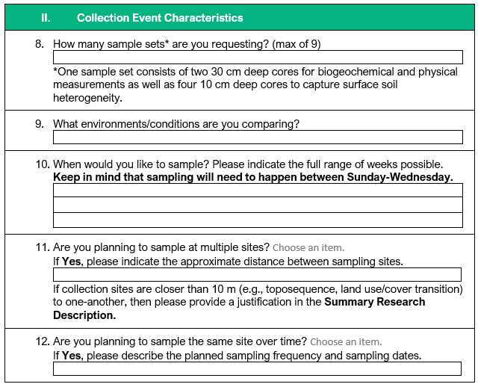
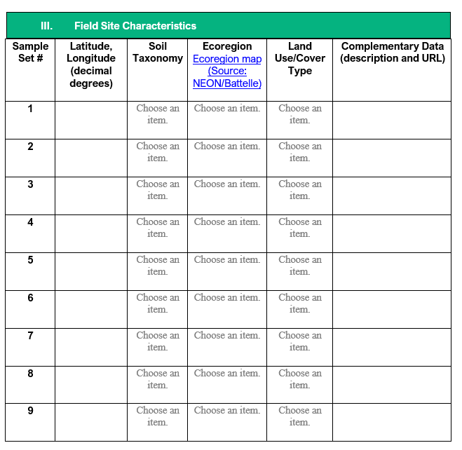
Demo of Small and Large Scope Request Forms

Slide 17

Thank you! Questions?

